Slide 1




Bank Note Authentication
Yogesh V. Rasal

Slide 2
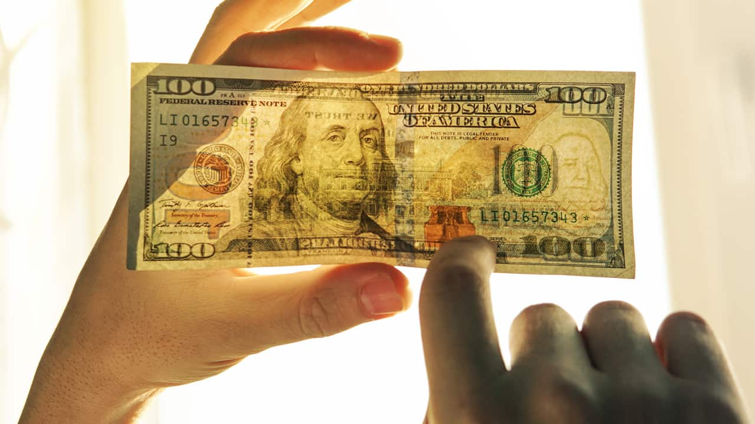
Introduction:
Bank Note Authentication aims to develop a reliable system for verifying the authenticity of banknotes, ensuring the security and integrity of financial transactions.
Problem Statement:
The project seeks to address the challenge of detecting counterfeit banknotes by developing an efficient and accurate authentication system using ML model that can differentiate between genuine and forged currency, enabling banks and businesses to safeguard their operations and protect the economy from fraudulent activities.

Slide 3
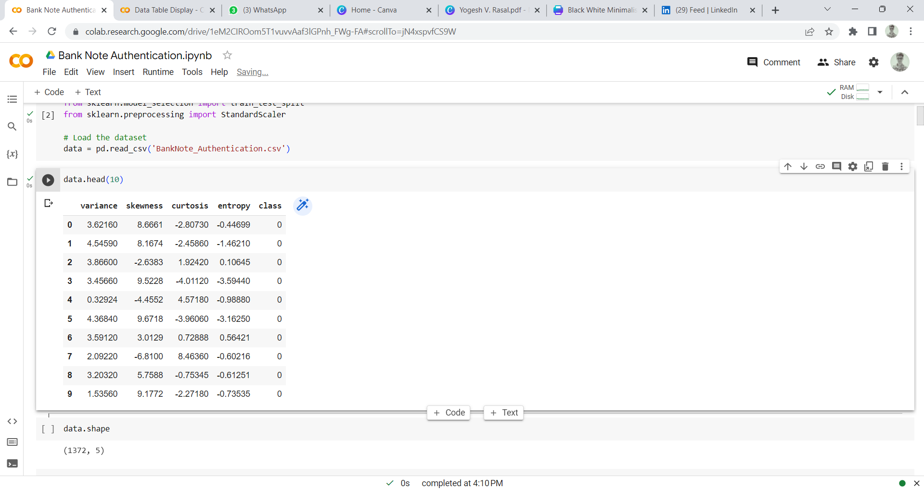
Information about the dataset
Images taken from fake and real banknote-like specimens were used to extract data. An industrial camera typically used for print inspection was used for digitization. 400 x 400 pixels make up the final images. Grayscale images with a resolution of about 660 dpi were obtained. In order to extract features from images, the Wavelet Transform tool was used. This data is derived from datasets from UCI.

Slide 4
Data Exploration
Histogram
Scatter Plot
Box Plot
Z-Score Box Plot

Slide 5
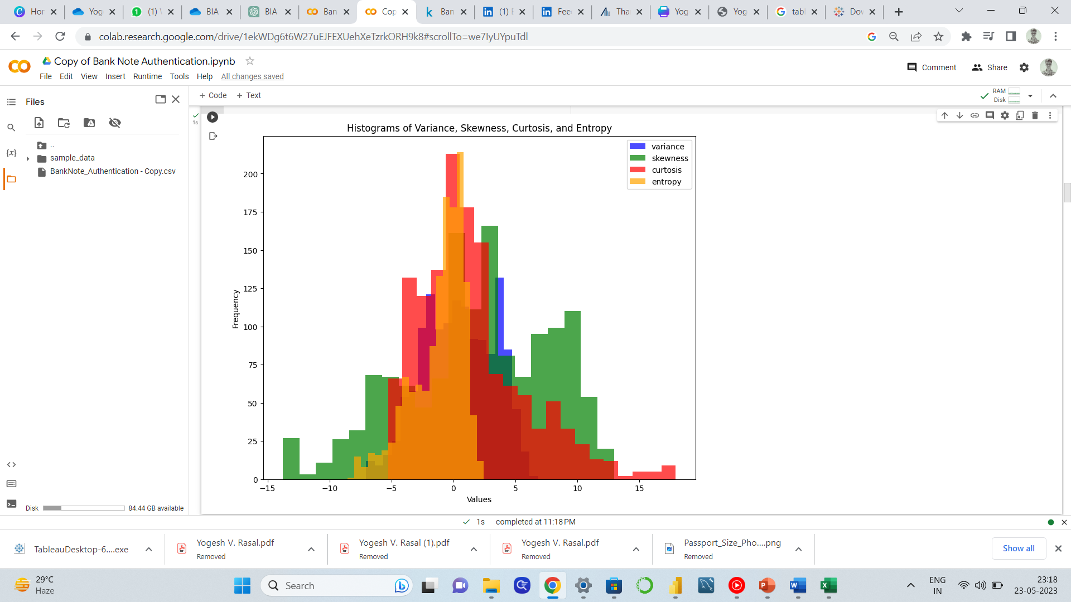
Histograms for each numerical feature to observe their distributions

Slide 6
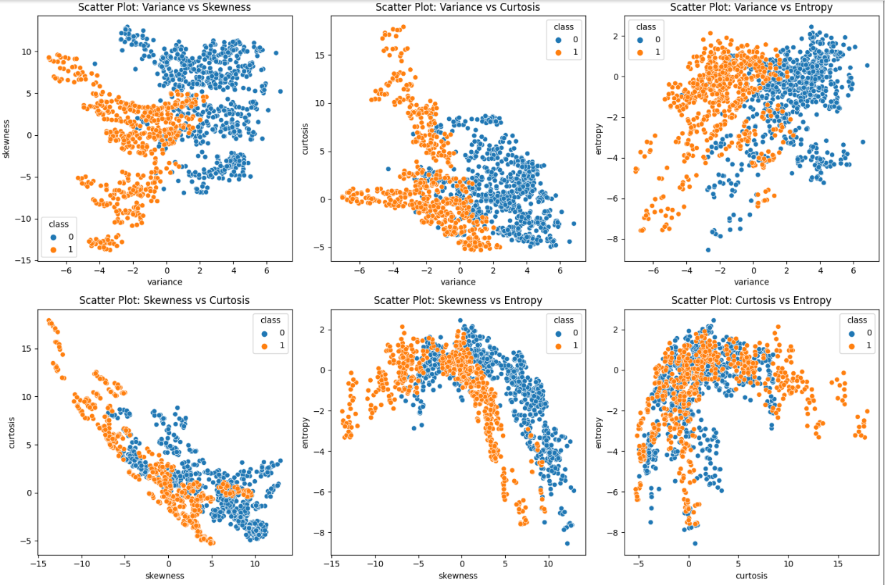
Scatter plots to visualize relationships between pairs of features

Slide 7
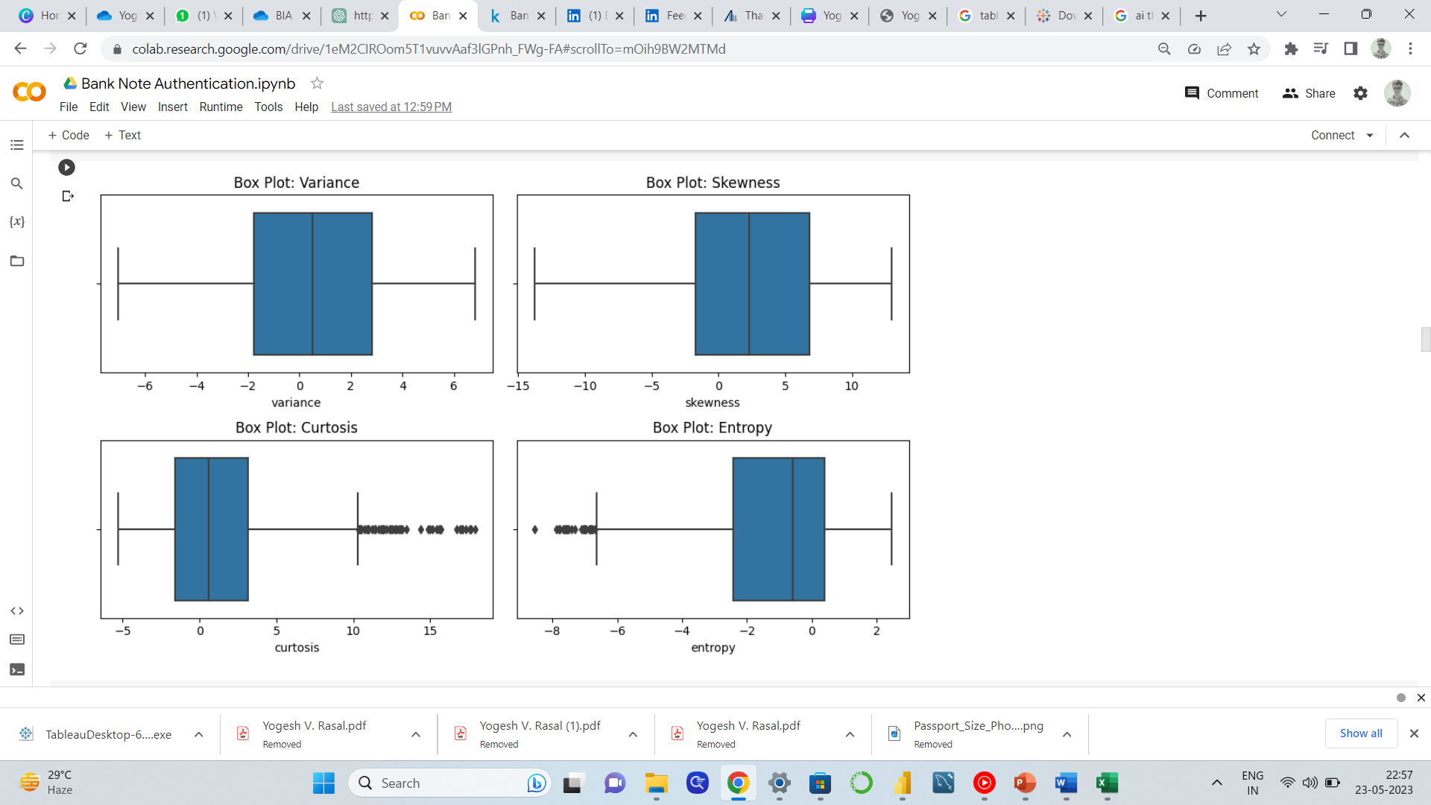
Box plots to visualize the distribution of each feature by class

Slide 8
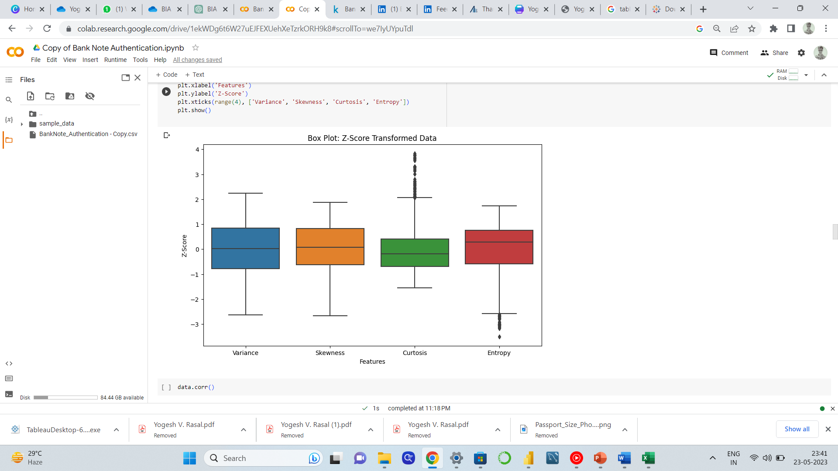
Identify potential outliers in the dataset

Slide 9
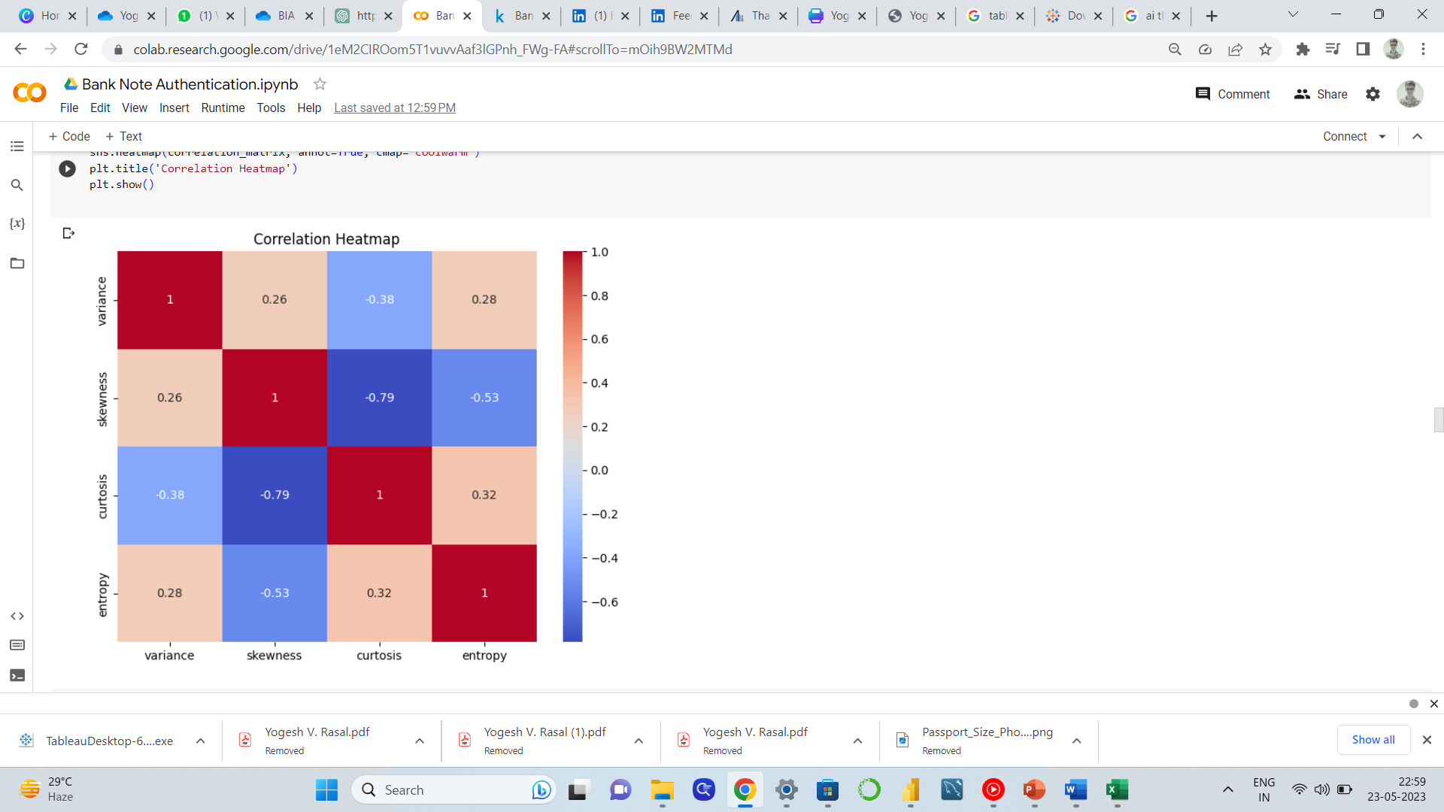
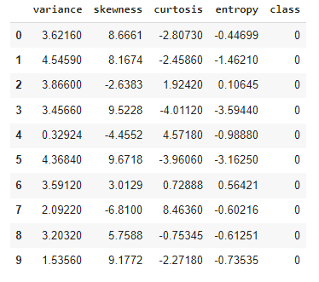
Preprocessing
Heatmap
Data Head
Data Shape

Slide 10
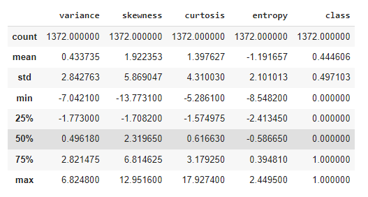
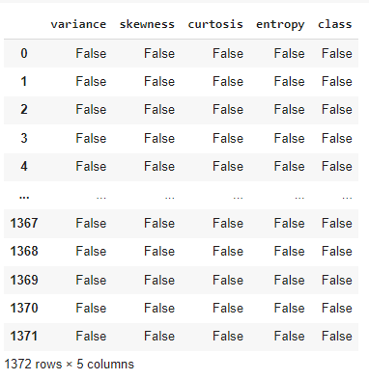
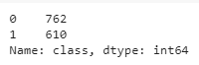
Descriptive Statistics
Missing Values
Class Value Count

Slide 11
Feature Selection
Seaborn
Matplotlib
scipy.stats
Epochs
Adam optimizer
Performance report

Slide 12
Model Selection
Neural Network Model
Logistic Regression Model

Slide 13
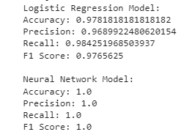
Result

Slide 14
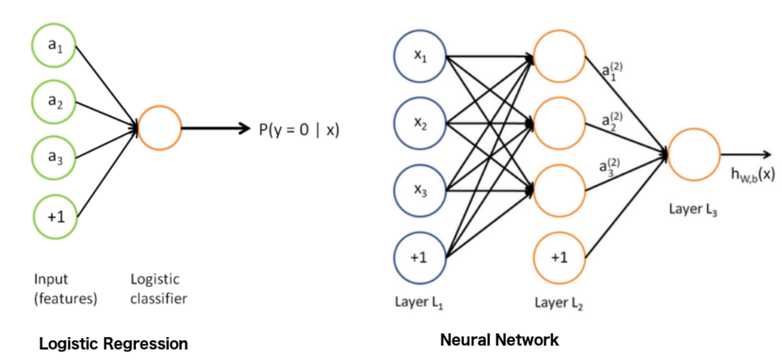
Conclusion

Slide 15
Thank you

